Slide 1
Displacement and Compasses

Slide 2
By the end of the lesson, you should be able to:
Recall what displacement is.
State the compass directions.

Slide 3

Displacement is a similar measure to distance, but it also tells you the direction in which an object has moved.
We use the symbol "s" to denote displacement, and its unit is metres (m).
For example, an object may have moved a distance of 2 m but have a displacement of 2 m to the left.

Slide 4
The displacement of an object is the shortest distance between the object's starting position and it's final position.

Slide 5
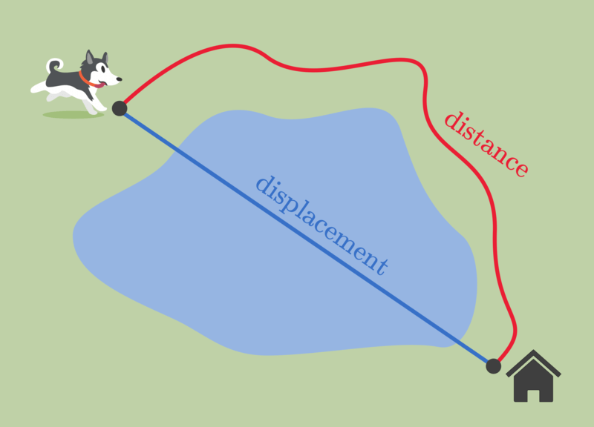
Harold the husky has to run around a pond in order to get home.
The length of the red path that he travels is the distance he runs.
However, his displacement is the direct distance between where he started and home.

Slide 6
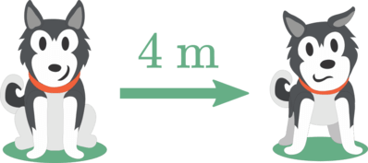
Displacement is a vector.
This means that it has a magnitude (size) and a direction.
For example, if your displacement is 4 m to the right, the magnitude of the displacement is 4 m and the direction of the displacement is to the right.

Slide 7

Instead of using terms like left, right, forwards and backwards, we use a compass to determine the direction that an object moved in.
Let's see how to use compasses to find directions.

Slide 8

We often use the directions north, east, south and west to describe the direction an object is displaced in.

Slide 9
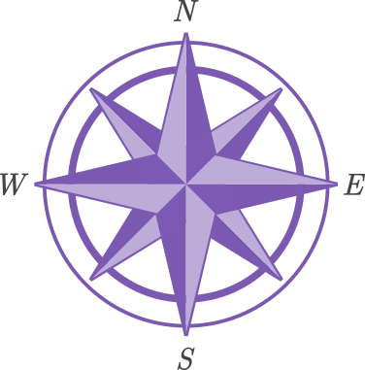
We use compasses, like the one pictured below, to tell us the direction.
N means north, E means east, S means south and W means west.
Never Eat Soggy Weetbix

Slide 10
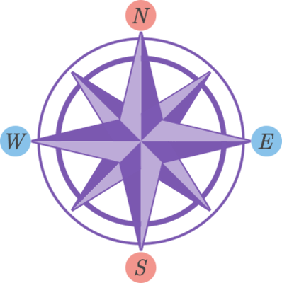
North and south point in opposite directions.
East and west also point in opposite directions.

Slide 11
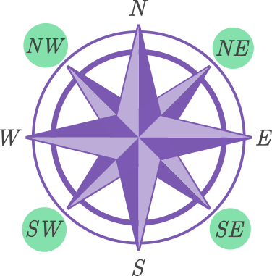
You may get questions where the displacement is halfway between either north or south and east or west. For instance, if you walk 2 m north and then 2 m east, your displacement is to the north-east (NE).
Other possible directions are north-west (NW), south-east (SE) and south-west (SW).

